Slide 1
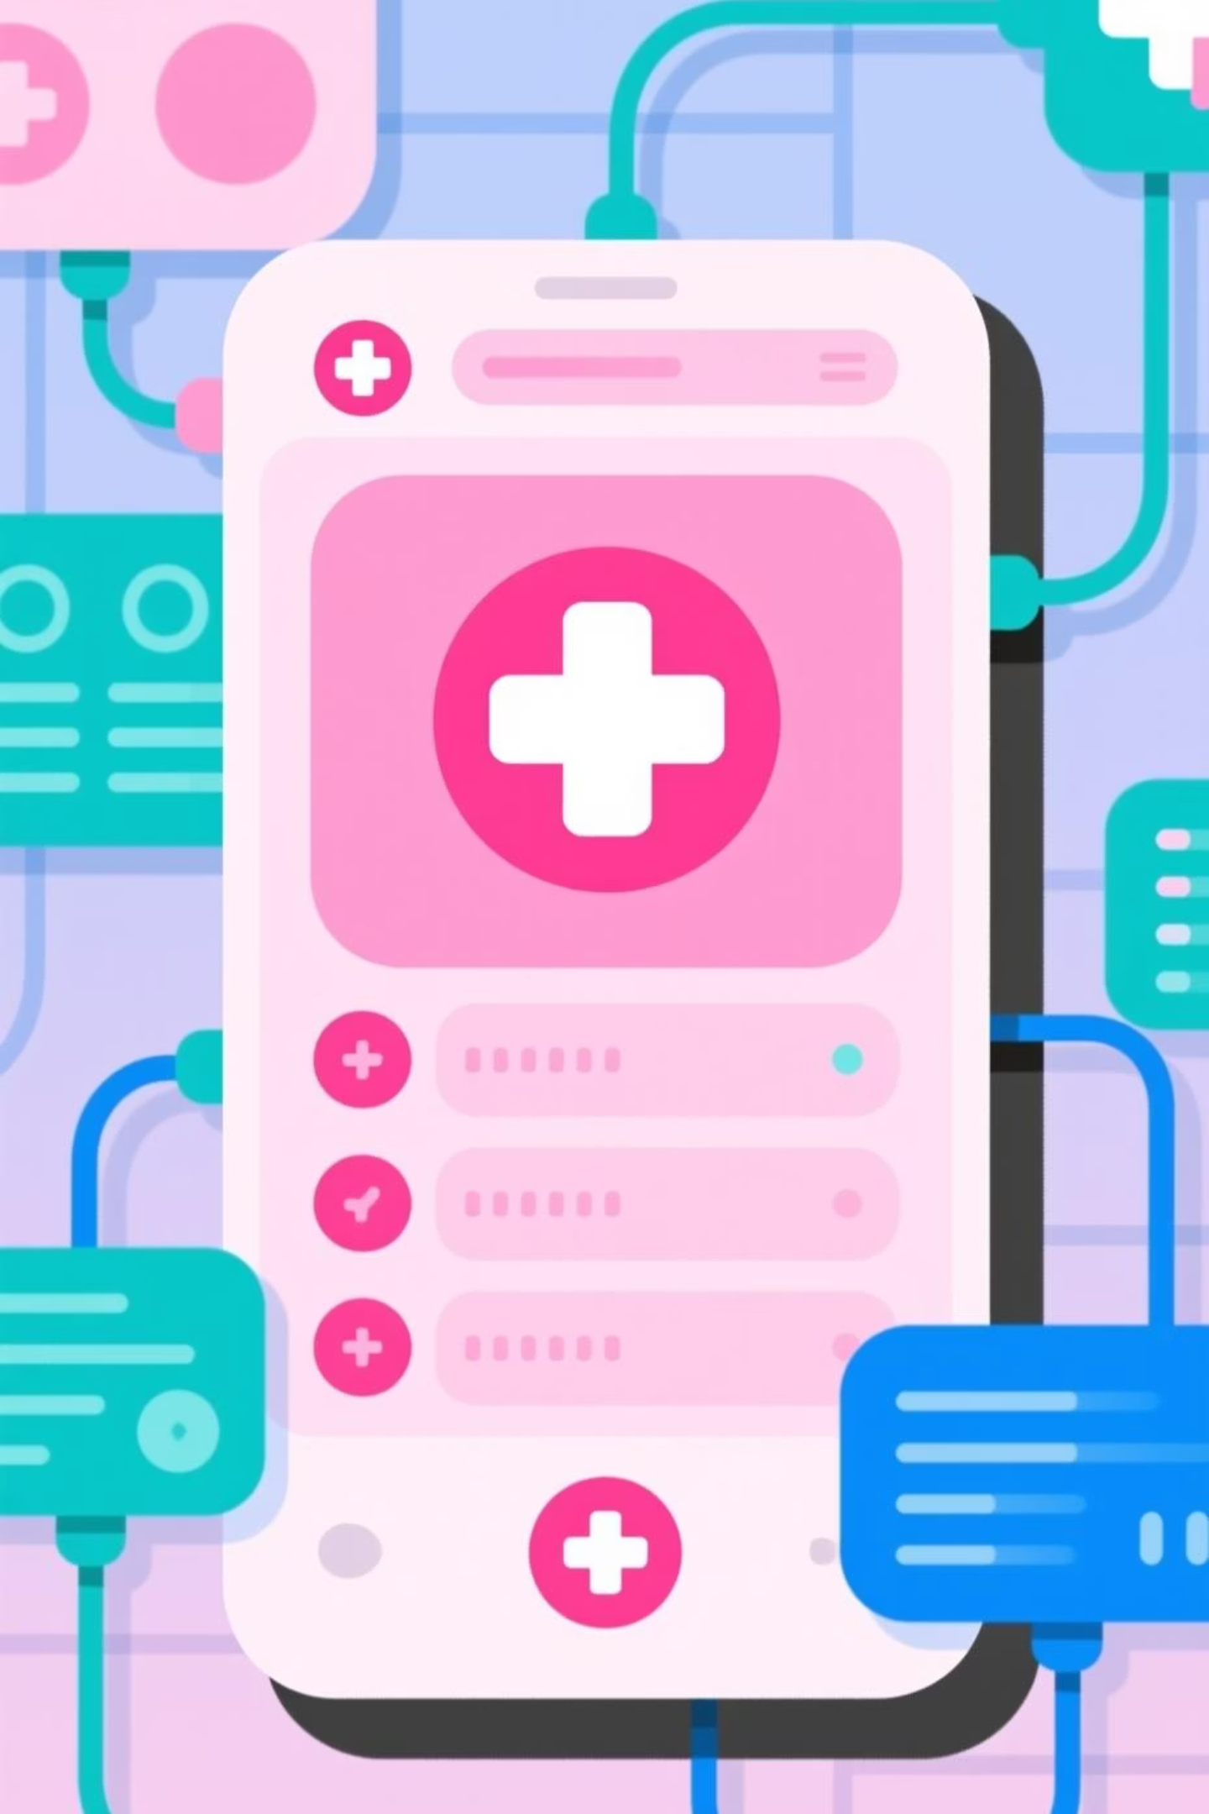
HealthSync: Unifying Care, Simplifying Journeys
An end-to-end smart healthcare management platform designed to transform patient care and streamline clinical operations across India's diverse healthcare landscape.

Slide 2

The Challenge: A Fragmented Healthcare Experience
The current healthcare system is broken for everyone. Patients and providers are trapped in inefficient, disconnected systems that compromise care quality and create unnecessary friction at every touchpoint.
The Patient's Daily Struggle
The Provider's Administrative Burden
Endless Wait Times: Hours spent in crowded waiting rooms and weeks for appointment slots
Manual Overload: Valuable staff time consumed by repetitive scheduling and data entry tasks
Appointment Chaos: Confusing schedules, missed reminders, and frequent double bookings
Fragmented Information: No unified patient history view, leading to redundant tests and delayed decisions
Scattered Health Data: Medical records, prescriptions, and lab reports distributed across multiple hospitals with no unified access
Compliance Risks: Challenges in maintaining HIPAA standards across multiple insecure communication channels
Communication Gaps: Difficulty reaching doctors for follow-ups or clarifications on treatment plans
Operational Inefficiency: Revenue loss from high no-show rates and administrative bottlenecks
This fragmentation leads to patient dissatisfaction, provider burnout, compromised care quality, and significant revenue leakage for healthcare institutions.

Slide 3

The Solution: Introducing HealthSync
One platform delivering seamless care for all stakeholders. HealthSync is a comprehensive healthcare portal that connects patients, doctors, and administrators in a single, secure, intelligent ecosystem.
Centralised Health Hub
Multi-Role Intelligence
Integrated Teleconsultation
A single, secure repository for all patient data—appointments, prescriptions, diagnostic reports, and complete medical history accessible anytime, anywhere.
Tailored, intuitive interfaces designed specifically for patients, doctors, and administrators, each optimised for their unique workflows and requirements.
Built-in, secure video calling infrastructure for virtual consultations, eliminating geographical barriers and expanding access to quality healthcare.
Smart Automation Engine
Security by Design
Intelligent reminders and notifications that reduce no-shows by up to 60% whilst improving medication adherence and follow-up compliance.
HIPAA compliance and advanced data privacy protocols are foundational principles, ensuring patient data protection meets international standards.

Slide 4



The Design & Validation Process
Driven by research, refined through testing. Our human-centred design methodology ensured we built the right solution by validating every decision with real users throughout the development journey.
User Research
Collaborative Design
Rigorous Validation
In-depth interviews with 50+ patients, doctors, and administrators across urban and rural healthcare settings to understand pain points and expectations.
Iterative prototyping in Figma and Adobe XD, with real-time collaboration using Miro for user flow mapping and information architecture.
Extensive usability testing with Useberry, gathering quantitative and qualitative feedback to refine the experience across all user personas.
Design Tools
Collaboration
Data Analysis
Figma, Adobe XD for high-fidelity prototyping and pixel-perfect UI/UX design
Miro for brainstorming, journey mapping, and stakeholder alignment workshops
Google Sheets for meticulous data mapping and user journey pain point analysis
The outcome: A deeply intuitive, user-validated prototype that addresses real-world needs, ensuring high adoption rates and satisfaction from day one across diverse user groups.

Slide 5
Transforming the Healthcare Experience
HealthSync delivers measurable value for every stakeholder in the healthcare ecosystem, creating a new standard for digital healthcare delivery whilst driving tangible business outcomes.
For Patients
For Doctors & Clinical Staff
For Healthcare Systems
40% reduction in overall wait times for appointments and consultations
20% boost in administrative efficiency, freeing time for patient care
Significant increase in patient satisfaction scores and loyalty metrics
Effortless booking with 24/7 access to complete health records
Streamlined workflows with unified patient view and complete history
60% reduction in no-show rates improving revenue and capacity utilisation
Seamless integration of virtual and in-person care experiences
Secure, integrated communication reducing phone tag and delays
Enhanced compliance with strengthened data security and audit trails
Improved health literacy through easy access to medical information
Better clinical decision-making with instant access to comprehensive data
Competitive advantage through modern, patient-centric digital infrastructure
Outcome: Empowered, engaged patients who actively participate in their healthcare journey
Outcome: Focused, efficient providers delivering higher quality care with reduced burnout
Outcome: A modern, competitive institution positioned for sustainable growth
HealthSync ensures smooth, transparent, and secure communication—building trust and improving health outcomes for all.

